Slide 1


HackToFuture-2024
In Association with
The Institution of Engineers (India)
Local Centre, Belagavi

Slide 2
Basic Details of the Team and Problem Statement
Domain :INTERNT OF THINGS(IOT)
PS Code: IOT -02
Problem Statement Title : IOT BASED SMART WASTE MANAGEMENT SYSTEM FOR SMART CITY
Team Name: BOLD VISIONS
Team Leader Name: SVAYAM S TOPAJICHE
Institute Name : KLS VISHWANATHRAO DESHPANDE INSTITUTE OF TECHNOLOGY ,HALIYAL -581329

Slide 3
Team members detail
Team Leader Name: SVAYAM S TOPAJICHE
Branch: BE , Stream : ECE ,Year :3
Team Member 1 Name: MITHALI R SADEKAR
Branch: BE, Stream : ECE, Year: 3
Team Member 2 Name: SAMIKSHA S KUSHALKAR
Branch: BE, Stream : ECE, Year: 3
Team Member 3 Name: ATIQUR RAHMAN SAYED
Branch: BE, Stream : ECE, Year: 3

Slide 4
GOOD MORNING AND WELCOME TO BOLD VISSION TEAM

Slide 5
TITLE OF PROJECT: SMART DUSTBIN WITH EPS8266 AND GPS

Slide 6
Aim of the project
Alerting of smart bin full / empty using IOT application to respective authority
To implement a smart bin built on microcontroller based platform Node MCU ESP8266 board
Which is interfaced with GSM modern and Ultrasonic sensor which can status of dustbin full or empty
Alerting the Municipal authority the dustbin full with waste

Slide 7
INTRODUCTION :
In this article, we will explain how we have create a Smart Dustbin using few components like a 16×2 LCD display, an ultrasonic sensor, a Sim800l module, a NEO-6m module, and the ESP8266 microcontroller. This integration of hardware and software will enable us to monitor the status of the dustbin, Find out the level of waste management, and provide real-time data for efficient collection and disposal.
Smart Dustbin works on the principle of object detection using an ultrasonic sensor. The ultrasonic sensor transmits sound waves. These waves get reflected whenever an object comes into the vicinity of the sensor. This generates an electrical signal which is used to open the dustbin lid.

Slide 8
Motivation of project
Seeing the use of cloud retrieve data at any time and any place
Also the use of wireless sensors made it possible of collect the data from cloud
We also have the moto of clean and hygienic environment so, we try to implement this system
Monitoring fill levels :The smart dustbin can monitor how full they are and alert authorities when they need to be emptied
Encouraging proper disposal
Detecting recyclables

Slide 9
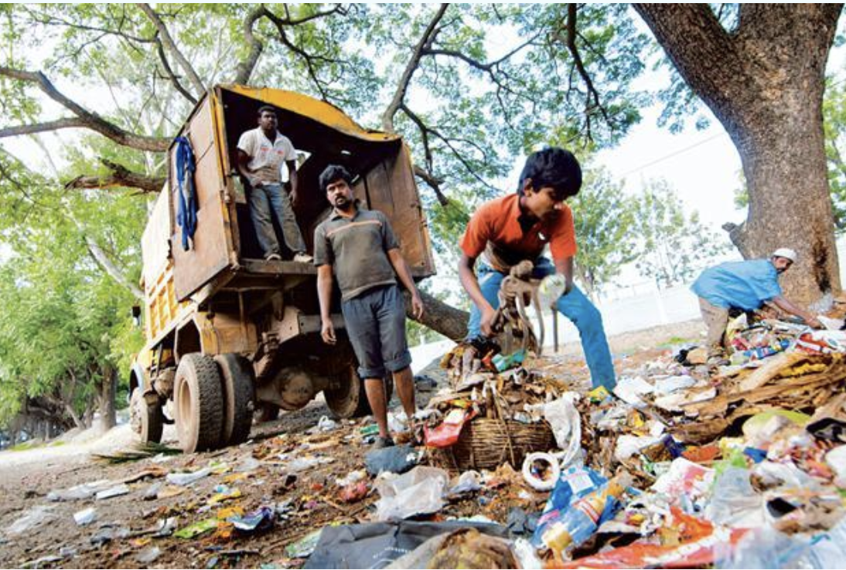

Problems facing
They typically lack access to sanitary and healthcare facilities. Furthermore, child labour is quite prevalent in this occupation and their life expectancy is low owing to continuous exposure to a hazardous environment. Sadly, waste pickers are not covered under any labour legislation in India.
In the present scenario as the population is increasing day by day the environment should be clean and hygienic.
In most of the cities, the overflowed garbage bins creating an unhygienic environment
This will further lead to arise of different types of unnamed disease
This will degrade the standard of living.

Slide 10
ABOUT SMART DUSTBIN AND WORKING
A smart dustbin is a regular trash can that has been integrated with hardware components to make it more efficient.
These components include sensors that can monitor the bin's fill level, temperature, and other parameters.
The sensors can then transmit this data to a central platform via IoT networks, allowing for real-time monitoring and alerts.
This information can help waste management teams optimize collection routes and reduce unnecessary pickups
WORKING PRINCIPLE:
Smart Dustbin works on the principle of object detection using an ultrasonic sensor.
The ultrasonic sensor transmits sound waves.
These waves get reflected whenever an object comes into the vicinity of the sensor.
This generates an electrical signal which is used to open the dustbin lid

Slide 11
FLOW CHART
START
LOGIN TO SERVER
REPEAT
CHECK WHETHER DUSTBIN IS FULL
SEND MESSAGE TO CONTROL ROOM
SEND CLEANING VEHICAL FOR CLEANING
UPDATE STATUS OF DUSTBIN
REPEAT

Slide 12
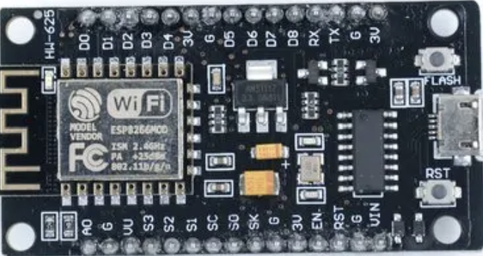
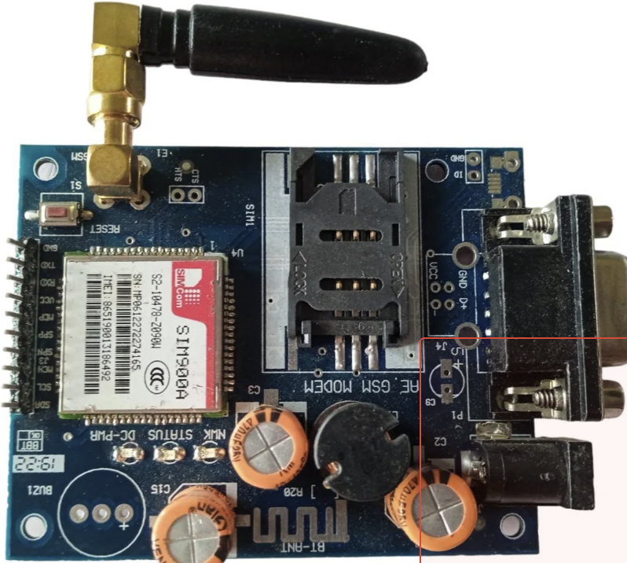
Components:
ESP8266 Controller : This project brings support for the ESP8266 chip to the Arduino environment. It lets you write sketches, using familiar Arduino functions and libraries, and run them directly on ESP8266, with no external microcontroller required.
ESP8266 Arduino core comes with libraries to communicate over Wi-Fi using TCP and UDP, set up HTTP, m DNS, SSDP, and DNS servers, do OTA updates, use a file system in flash memory, and work with SD cards, servos, SPI and I2C peripherals.
GSM Module(Global system for Mobile Communication) :A GSM module is a device that allows electronic devices to communicate with each other over the GSM network. GSM is a standard for digital cellular communications, which means that it provides a platform for mobile devices to communicate with each other wirelessly. The GSM module is a specialized device that enables a device to send and receive data over the GSM network.

Slide 13
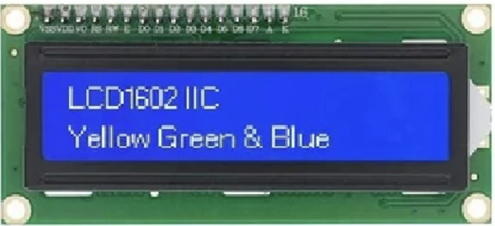
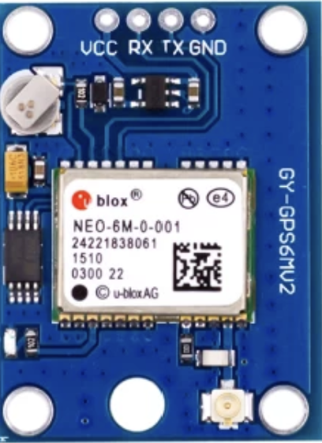
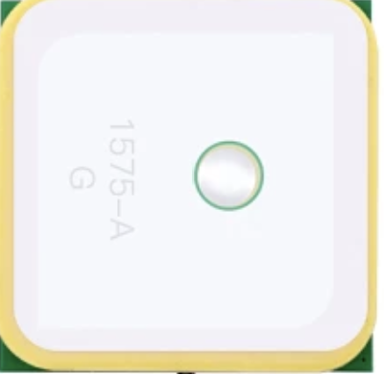
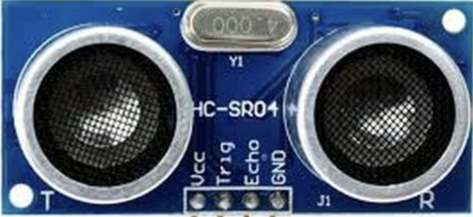
16×2 LCD Display with I2C : 16×2 LCD is an Alphanumeric display that can show up to 32 characters on a single screen. You can display more characters by scrolling the texts one by one. The I2C Module is used to reduce the no. of pins needed for the display.A 16×2 LCD means it can display 16 characters per line and there are 2 such lines. In this LCD each character is displayed in 5×7 pixel matrix. This LCD has two registers, namely, Command and Data.
GPS Module : One of the global positioning system (GPS) devices ultilize data from satellites to locate a specific point on the Earth in a process named trilateration. Meanwhile, a GPS receiver measures the distances to satellites using radio signals to trilaterate. And trilateration is similar to triangulation, which measures angles, depicted in this illustration (Tim Gunther, 2020). GPS modules contain tiny processors and antennas that directly receive data sent by satellites through dedicated RF frequencies. From there, it’ll receive timestamp from each visible satellites, along with other pieces of data. If the module’s antenna can spot 4 or more satellites, it’s able to accurately calculate its position and time.
Ultrasonic Sensor :Ultrasonic detection is one of the greatest ways of reliably sensing levels and determining proximity. Since they have been in use for many years, ultrasonic sensors have a significant portion of the sensing market. These sensors play a crucial role in countless applications, from industrial automation to robotics and automotive safety systems. In this brief overview, we’ll delve into the mechanics of ultrasonic sensor working. The use of ultrasonic sensors in various fields, such as drones and electric cars, is growing as the automation sector develops. This blog provides a deep knowledge of what is ultrasonic sensor and how it works.
Wires :
5v DC Power Supply :

Slide 14
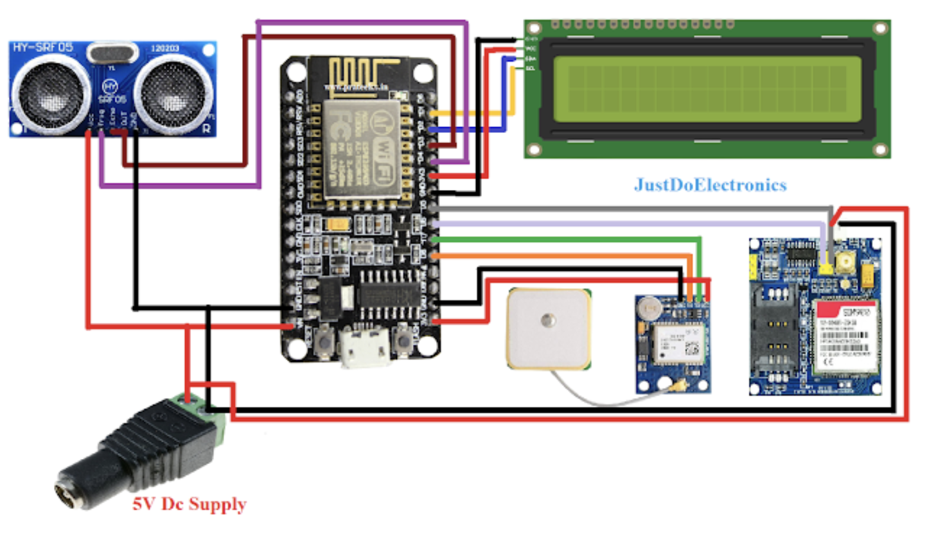
Circuit diagram :

Slide 15
PIN CONFIGRATION OF CIRCUIT:
1 LCD Display
SDA: Connected to the SDA pin of the ESP8266
SCL: Connected to the SCL pin of the ESP8266
VCC: Connected to the 5V power supply
GND: Connected to the ground (GND)
2 Ultrasonic Sensor
Trig: Connected to a digital pin (D6) of the ESP8266
Echo: Connected to a digital pin (D5) of the ESP8266
VCC: Connected to the 5V power supply
GND: Connected to the ground (GND)
3 GPS Module
RX: Connected to the TX pin (D4) of the ESP8266
TX: Connected to the RX pin (D3) of the ESP8266
VCC: Connected to the 5V power supply
GND: Connected to the ground (GND)
4 ESP8266
VCC: Connected to the 5V power supply
GND: Connected to the ground (GND)

Slide 16
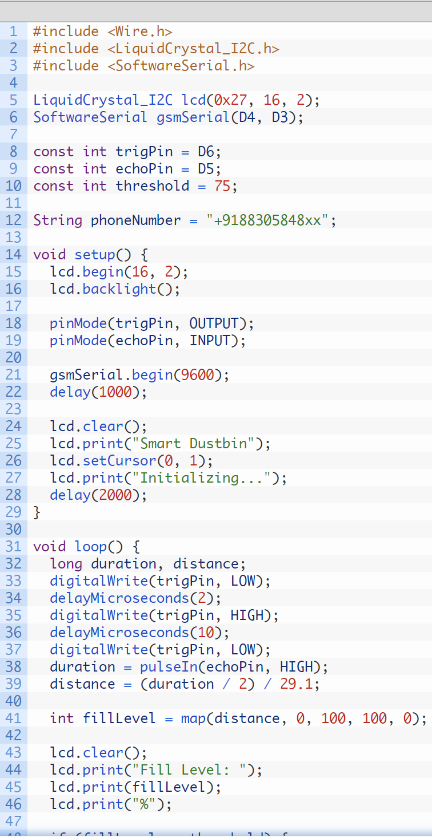
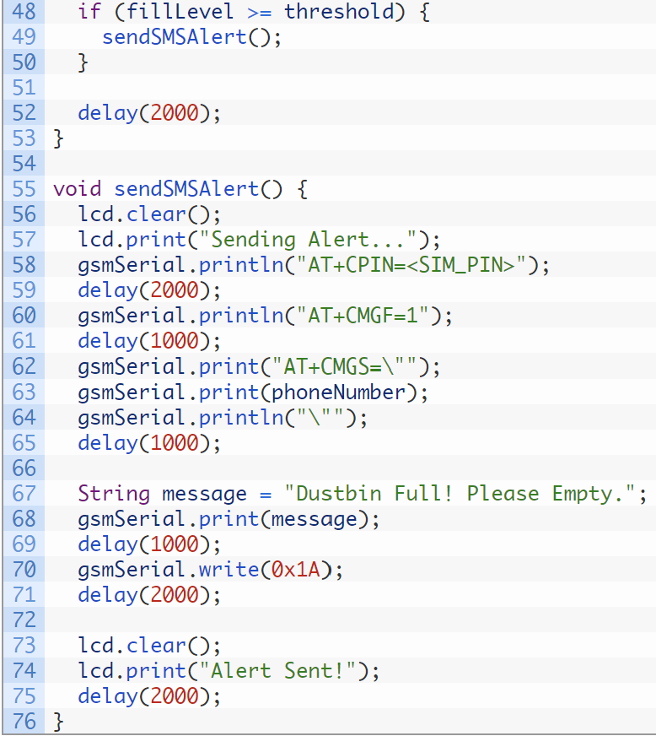
SOURCE OF CODE

Slide 17
The setup()function :When the microcontroller starts. It initializes the LCD display, sets the pin modes for the ultrasonic sensor (trig Pin as OUTPUT and echo Pin as INPUT), initializes the GSM module’s serial communication, and displays an initialization message on the LCD.
The loop() function :The main functionality of the code resides. It continuously measures the distance using the ultrasonic sensor, calculates the fill level percentage, and displays it on the LCD. If the fill level exceeds the threshold, the sendSMSAlert() function is called to send an SMS alert.
The send SMSAlert() function Responsible for sending an SMS alert. It sends AT commands to the GSM module via the gsmSerial object to set the necessary configurations, recipient phone number, and message content. Finally, it sends the SMS by writing 0x1A (ASCII code for Ctrl+Z) to the GSM module and displays an “Alert Sent!” message on the LCD

Slide 18
APPLICATIONS
Domestic
Hotels
Malls
Railway Station
Bus Stops
Gardens and Park
Colleges

Slide 19
FUTURE SCOPE :
Garbage will collected time to time
They can easily get notify about the Dustbin
They can track the location
Overfull of dustbin can be controlled

Slide 20
CONCLUSION:
This smart solution allows for real-time monitoring of the dustbin’s fill level, sends alerts to the appropriate authorities, and provides location data for efficient waste management. The integration of these components not only enhances waste collection practices but also contributes to building smarter and more sustainable cities.
With further advancements in IoT technology, the possibilities for optimizing waste management are endless. Smart dustbins can help improve waste management and environmental sustainability by reducing waste overflow and optimizing collection schedules

Slide 21
Thank you

